Slide 1
Survival analysis of ERBB2 and MYC CNVs in breast cancer
Lucija & Emily
BIO392, 30.04.2026

Slide 2
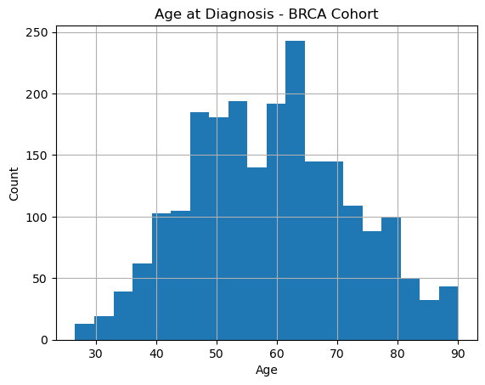
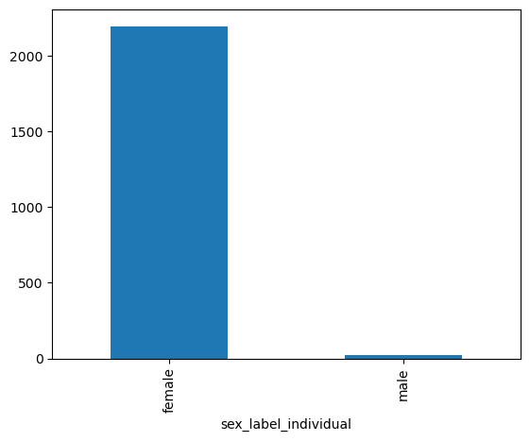
Demographics – BRCA cohort
Notes:
Merge Biosample and Individual with individual_id:2219

Slide 3
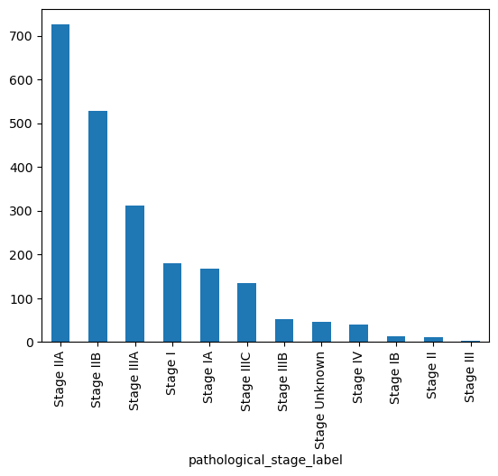
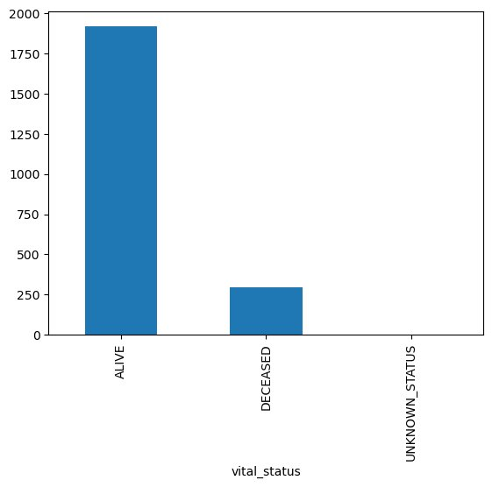
Stage and overall survival – BRCA Cohort

Slide 4
ERBB2
(HER2)
Receptor Tyrosine Kinase
ERBB2 (HER2) is one of four membrane tyrosine kinase receptors in the ERBB family, regulating cell proliferation, survival, and differentiation.
Introduction
15–20%
Prevalence in Breast Cancer
ERBB2 amplification or overexpression occurs in 15–20% of breast tumours.
of breast cancers
are HER2-positive
Prognostic Significance
ERBB2 amplification is a prognostic marker for aggressive tumours and a predictive marker for response to HER2-targeted therapies.
Drago, Joshua Z et al. “Beyond HER2: Targeting the ErbB receptor family in breast cancer.” Cancer treatment reviews vol. 109 (2022): 102436. doi:10.1016/j.ctrv.2022.102436

Slide 5
Dataset
Total number of samples: 991
ERBB2_hit:184
ERBB2_gain_hit:104
ERBB2_loss_hit: 79

Slide 6
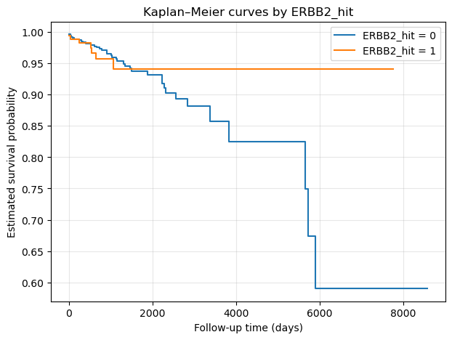
Kaplan–Meier survival analysis

Slide 7
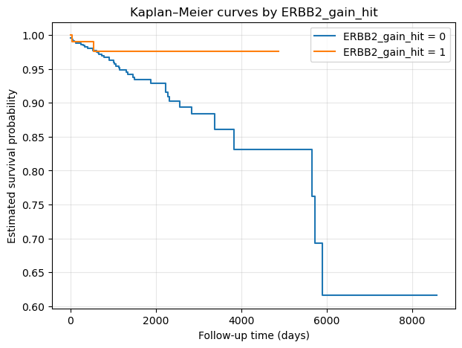
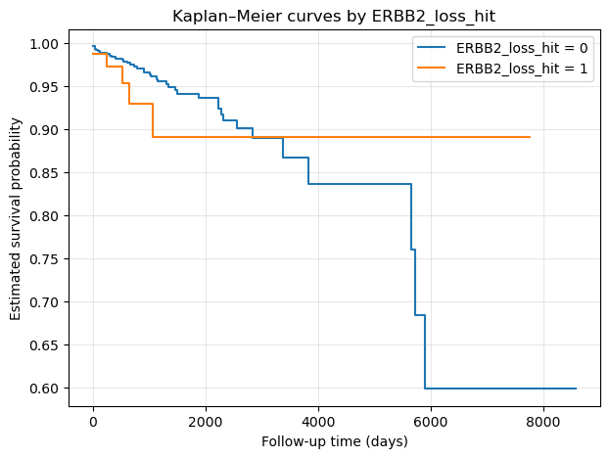
Kaplan–Meier survival analysis

Slide 8
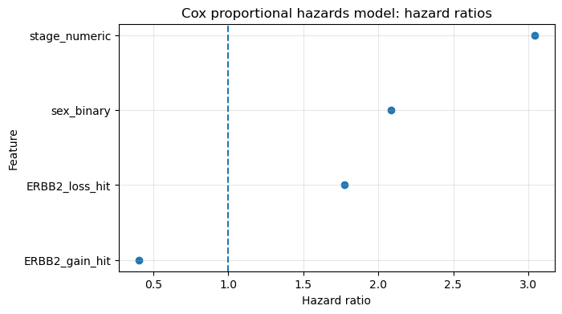
Cox proportional hazards model
Feature | Coefficient | Hazard ratio
ERBB2 gain hit | -0.911537 | 0.401906
ERBB2 loss hit | 0.572842 | 1.773299
Sex | 0.733760 | 2.082898
Stage | 1.112955 | 3.043339
Concordance index: 0.7049654280053375
Notes:
First run the model without the stage covariate > HR of gain was alsmost the same as seen here, erbb2 loss was about 1.5, sex was 2.5
Stage is the stongest predictor > by one stage increse patient has 3x higher risk of death
Index: very good > model with 4 covariates (ERBB2 gain/loss, sex, stage) correctly ranks ~70.5% of patient pairs by survival outcome
It is very contradictive than expected, from the literature we would expect that gain hits would increse the risk of death rather than decreasing it
Lose hits would not lead to sig change in risk death

Slide 9
Conclusions
Few death events in the altered groups: The flat KM curves for both gain and loss groups strongly suggest very few death events occurred in those patients during follow-up.
ERBB2 gain patients may be systematically treated differently HER2+ patients (ERBB2 amplified) receive targeted therapy like trastuzumab (Herceptin), which dramatically improves survival.
CNV gain ≠ HER2 overexpression: ERBB2's clinical relevance comes from protein overexpression, not just copy number gain
Hansen, Thomas V O et al. “High-density SNP arrays improve detection of HER2 amplification and polyploidy in breast tumors.” BMC cancer vol. 15 35. 6 Feb. 2015, doi:10.1186/s12885-015-1035-1

Slide 10
MYC
Function
Downstream effector of ERBB2 signaling
Transcription factor that controls cell cycle progression, cell growth, metabolism etc.
Oncogene
02
15–30%
of breast cancers overexpress MYC
Prevalence in Breast Cancer
MYC overexpression occurs in 15–30% of breast tumors, amplification is even more common.
Prognostic Significance
04
High MYC is associated with aggressive disease and poor diagnosis.
05
Corey Lourenco et al., Nature 2021. MYC protein interactors in gene transcription and cancer
Notes:
We wanted to run the model also for another gene involved in breast cancer, and we chose MYC is a downstream effector of ERBB2 signaling and an oncogene. 15-30% of breast cancers overexpress MYC, and overexpression or amplification of it is associated with aggressive disease and poor diagnosis. Therefore, in our survival analysis, we expect worse survival for MYC gain.

Slide 11
MYC dataset
Total number of samples: 991
MYC hits: 589
MYC gains: 365
MYC losses: 489

Slide 12
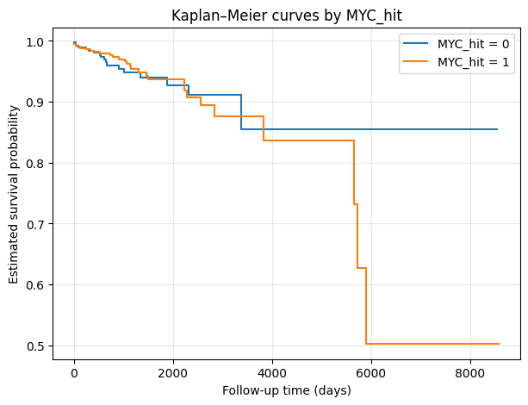
Kaplan-Meier survival Analysis
Notes:
In the Kaplan-Meier analysis, we see that the survival probability was significantly worse when there were CNVs of MYC.

Slide 13
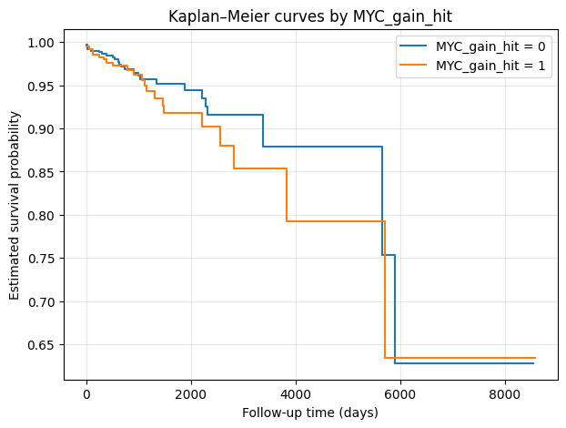
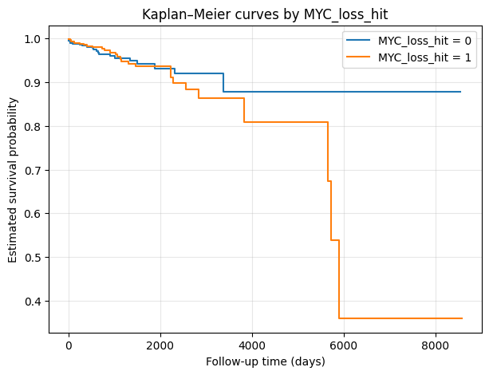
Kaplan-Meier survival Analysis
Notes:
However, when we look at the gains and losses, we see something counterintuitative: a slightly lower survival probability for a MYC CNV gain and a much lower survival for MYC loss.
It's important to mention that MYC losses occurred very often, in almost half of the samples. This might explain some of it, but not all. Therefore, we thought that there were some confounding factors that affected survival, especially the stage of the cancer.
Important: this is without adjustment for stage.

Slide 14
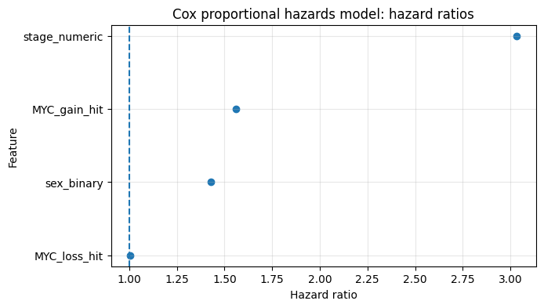
Cox proportional hazards model
Feature | Coefficient | Hazard ratio
MYC gain hit | 0.44 | 1.56
MYC loss hit | 0.0016 | 1.01
Sex | 0.36 | 1.43
Stage | 1.11 | 3.03
Concordance ratio: 0.695
Notes:
First ran the model without stage: showed high hazard ratio for loss hit, low hazard ratio for gain hit.
Then we ran the model to include the stage to see if it was a confounding factor, and that looks much better.
MYC gain HR = 1.56 makes a lot of sense — amplification of the oncogene should worsen survival
MYC loss HR = 1.01 is essentially neutral, which also makes sense
Stage HR was very high, what we expect. It was nearly identical like in the ERBB2 model, which is a great internal validation.
High concordance ratio, so model fits well.

Slide 15
Conclusion - MYC
Stage was an important confounding variable
Running a survival analysis that takes stage (and other possible confounding variables) into account would likely yield more conclusive results
Should be done in the next step
Notes:
The cox model improved a lot when we took stage into account, so it was an important confounding variable.
As a next step, we should run the kaplan meier survival analysis or another survival analysis that takes stage, and other possible confounding variables such as age or treatment into account, to see if it yields more intuitive results.

Slide 16
Conclusions and Discussion
MYC survival analysis supported our previous assumptions better than ERBB2
CNV data is not the best for determining over-/ or underexpression of the genes => IHC for protein expression would be better suited
There might be more confounding factors, such as age or treatment, that should also be included in the model
It would also be interesting to look at the survival rates for MYC and ERBB2 co-expression
Notes:
MYC survival analysis worked better than ERBB2: might also be bcs it's not directly treatable like ERBB2+ breast cancer
CNV data is not the best for determining over-/ or underexpressionof the genes => IHC for protein expression would be better suited
There might be more confounding factors, such as age ortreatment, that should also be included in the model
It would also be interesting to look at the survival rates for MYCand ERBB2 co-expression

